Slide 1
An Analysis of the Space Economy
Charles Zhang & Terry Zheng

Slide 2



Our Team
Charles Zhang
B.S. Economics
B.S. Statistics and Analytics
Terry Zheng
B.A. Computer Science
B.S. Statistics and Analytics

Slide 3
Table of Contents
What is the Space Economy
Models + Deeper Visualizations
01
04
Data Manipulation
Findings
02
05
Data Visualizations
Closing Thoughts
03
06

Slide 4
What is the Space Economy?

Slide 5
What is it?
The space economy refers to the economic impact of space related industries and activities.
Every year the space economy employs hundreds of thousands of employees and provides millions in real value created.
Through our project, we hope to better understand the what drives value behind the space economy. Which industries have the largest and smallest effect on the space economy and how can we predict where the space economy will be in the next few years?

Slide 6
Datasets
Our datasets comes from the U.S. Bureau of Economic Analysis and displays the economic impact of space-related industries and activities in the United States.
Data includes real, current‐dollar, and price data for space economy value added and gross output by industry, as well as space economy private sector compensation and employment by industry.
Table 1: Space Economy Real Value Added by Industry
Table 2: Space Economy Value Added by Industry
Table 3: Space Economy Value Added Price Indexes by Industry
Table 4: Space Economy Real Gross Output by Industry
Table 5: Space Economy Gross Output by Industry
Table 6: Space Economy Gross Output Price Indexes by Industry
Table 7: Space Economy Employment by Industry
Table 8: Space Economy Compensation by Industry

Slide 7
Industries
The industries are defined according to the 2017 North American Industry Classification System (NAICS)​
Manufacturing
Construction
Wholesale Trade
Retail Trade
Transportation and Warehousing
Information
Finance​
Business​
Educational and Healthcare​
Entertainment and Recreation​
Government​
Others

Slide 8
01
Data Manipulation

Slide 9
Data Wrangling
Removing Unnecessary Tables (2, 3, 5, and 7):
We only wanted data in real terms, or in other words adjusted for inflation
All values are compared to 2017 price levels
Removing Rows:
Removed the subindustries, utilizing the main industries that they create
Removed the industries where there were missing information
Created Table 8 in Real Numbers
Used the price index in Table 6 and changed all numbers in terms of 2017 dollars

Slide 10
Notes on the Data
By converting all dollar units in terms of real terms we can better make inferences on the data, as it now better reflects the purchasing power.
When manipulating the data, we noticed a discrepancy between value added from the government and value added from the private sector vs. the total value added.
This discrepancy is likely caused by:
Data values themselves being simply estimates or rounding errors
Missing Industries
The missing data from the industries that were removed
Government data is not provided in employee compensation and total number of employees data sheets

Slide 11
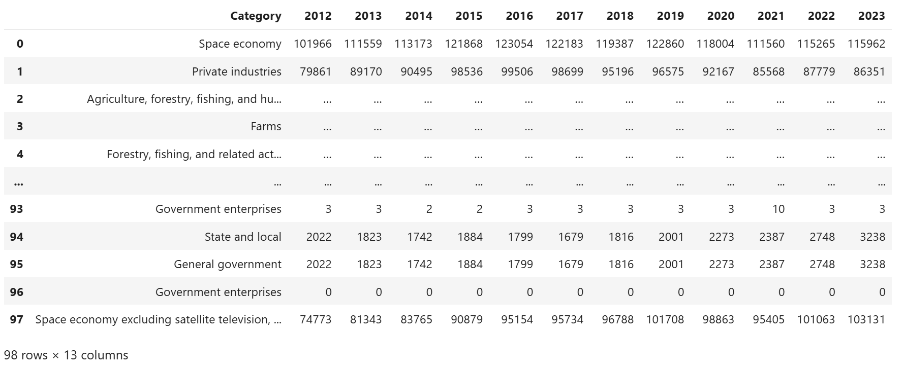
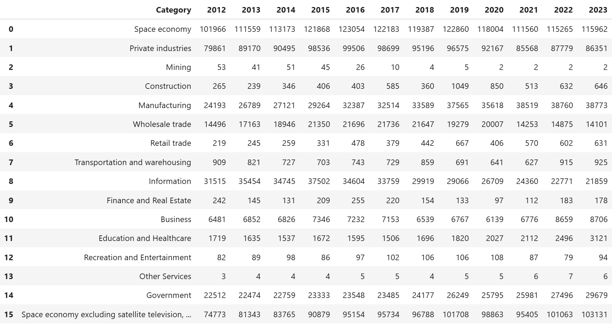
Uncleaned
Cleaned

Slide 12

03
Data Visualizations

Slide 13
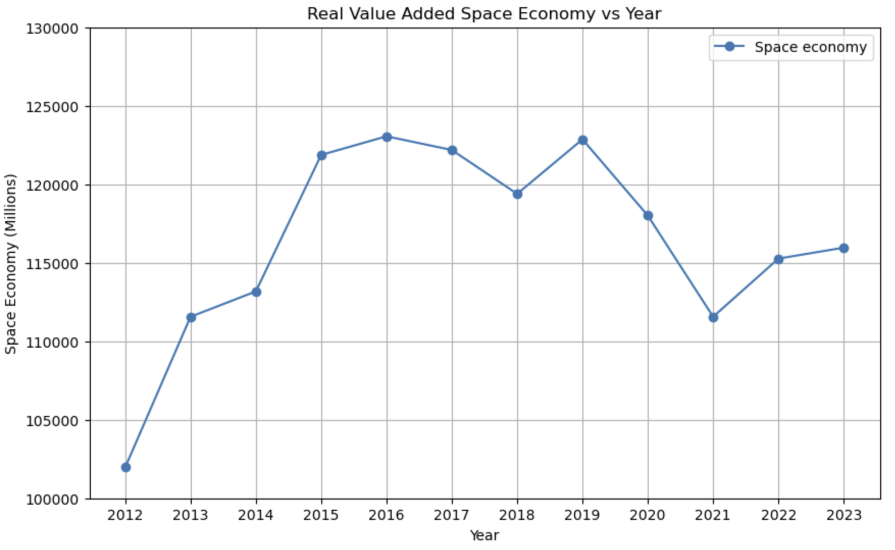
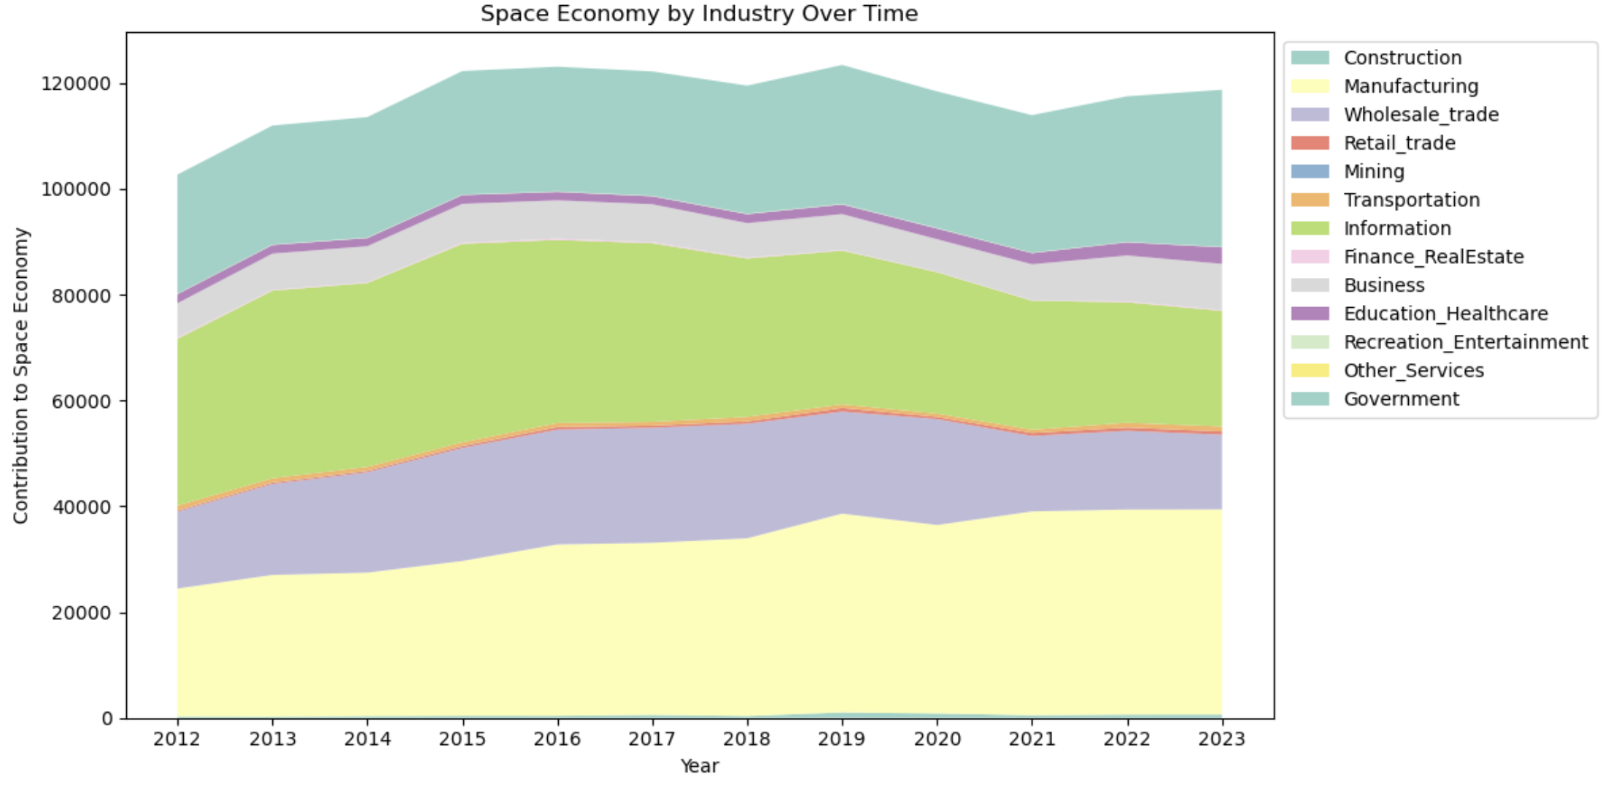
Space Economy (Real Value Added)
As shown by the graph below, the Space Economy’s real value added comes mainly from the private sector.
Construction, Manufacturing, Wholesale trade, and Information are contributing the most to the Space Economy. This makes sense, as a large part of Value Added is wages(labor costs) and Satellite related activities (next slide).
As shown by the graph above, the Space Economy’s real value was heavily impacted around the 2021 mark, most likely due to Covid.

Slide 14
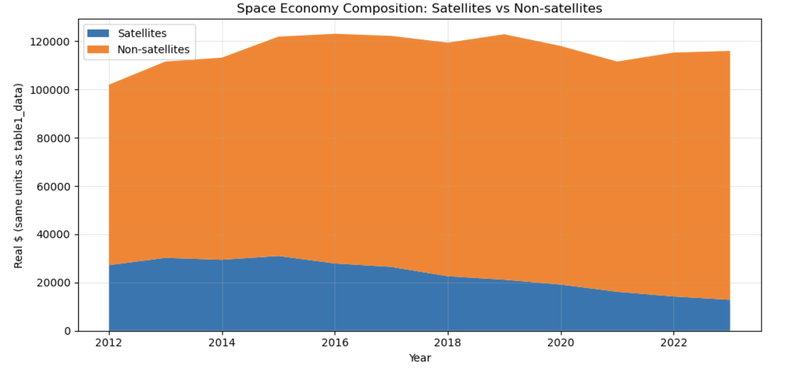
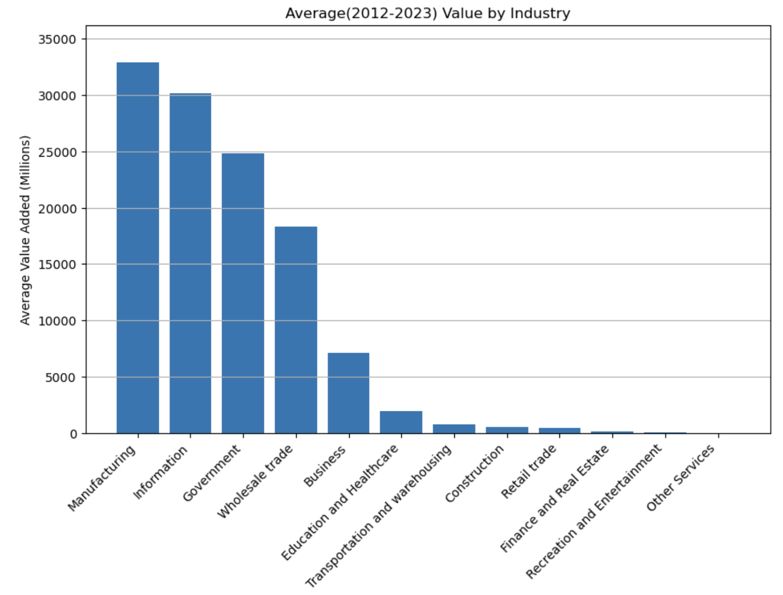
Space Economy (Real Value Added)
As you can see from above, satellites make around a quarter of the space economy ,but their shares have steadily decreased since.
The graph on the right gives us an idea of who is taking their place, while also saying that the industry is diversifying and broadening

Slide 15
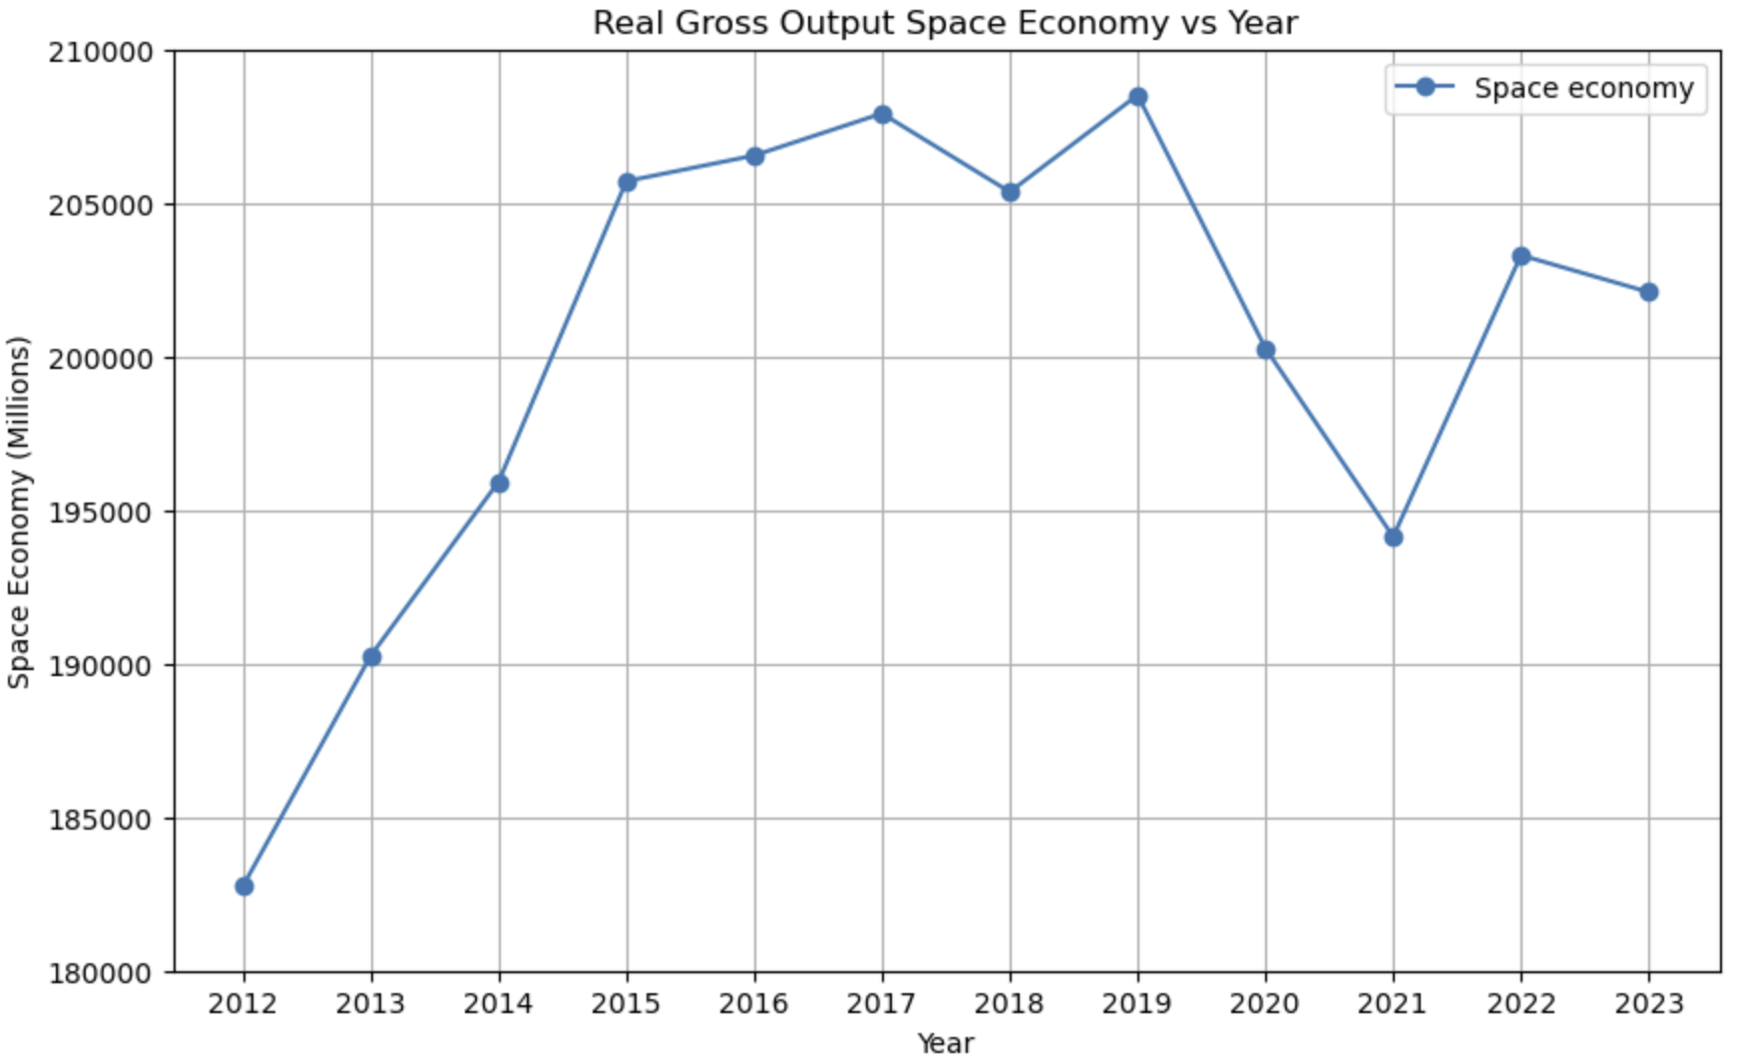
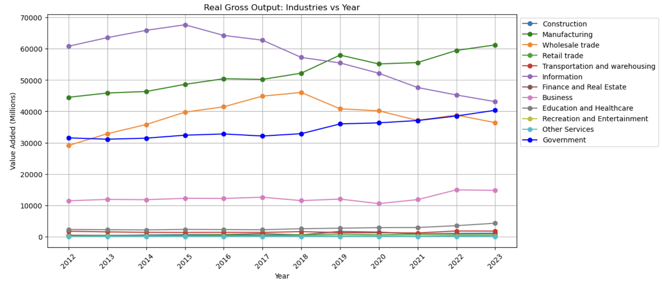
Space Economy (Real Gross Output)
Then space economy’s production base is anchored by manufacturing and information sectors, reflecting hardware and data-driven services.
The decline in wholesale trade after 2017 suggests changes in distribution and intermediation within the industry.
The space economy expanded significantly during the 2010s, but growth has plateaued and become more volatile recently.
Once again, the large shock in 2021 is most likely due to the pandemic. It also shows that the Space Economy has been slow to recover.

Slide 16

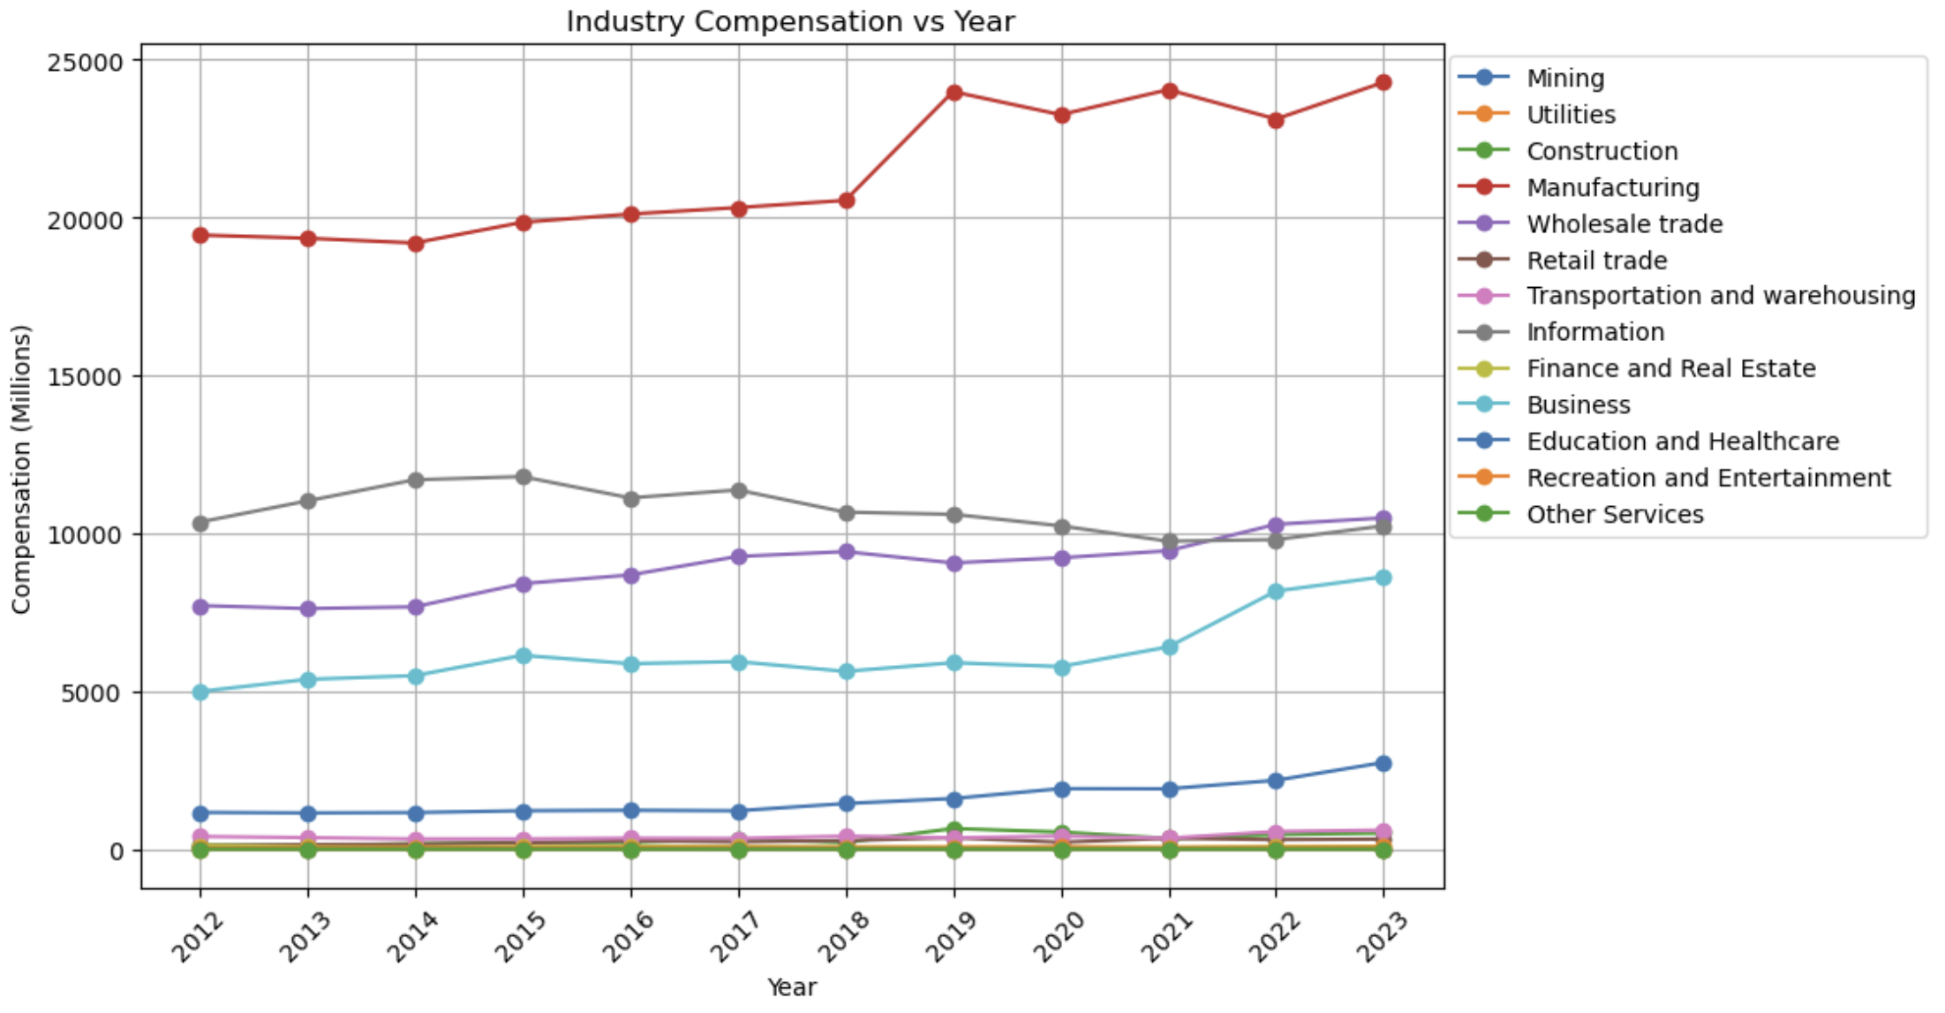
Space Economy Compensation by Industry
The rise in total compensation within the Space Economy is largely driven by the manufacturing industry.
This highlights how labor-intensive sectors like manufacturing play an large role in linking compensation to overall value added.

Slide 17
04
Models + Deeper Visualizations

Slide 18
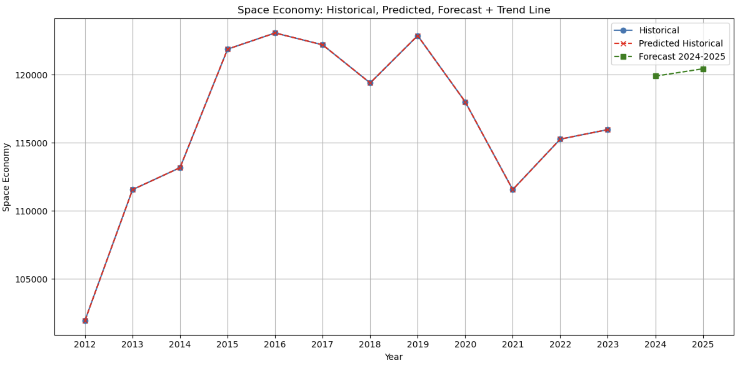
Prediction model for the Value Added from the Space Economy in 2024 and 2025 R²: 1.0 RMSE: 1.925037439697619e-11
120424
119888

Slide 19
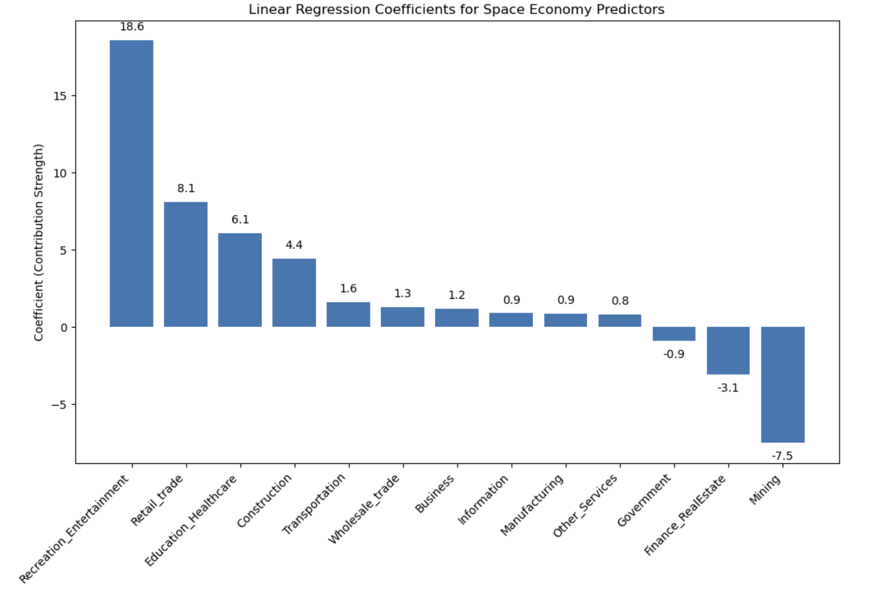
Coefficients Holding the other variable constant, a one-unit increase in an industry is associated with a change of the coefficient value of units in the Space Economy.

Slide 20
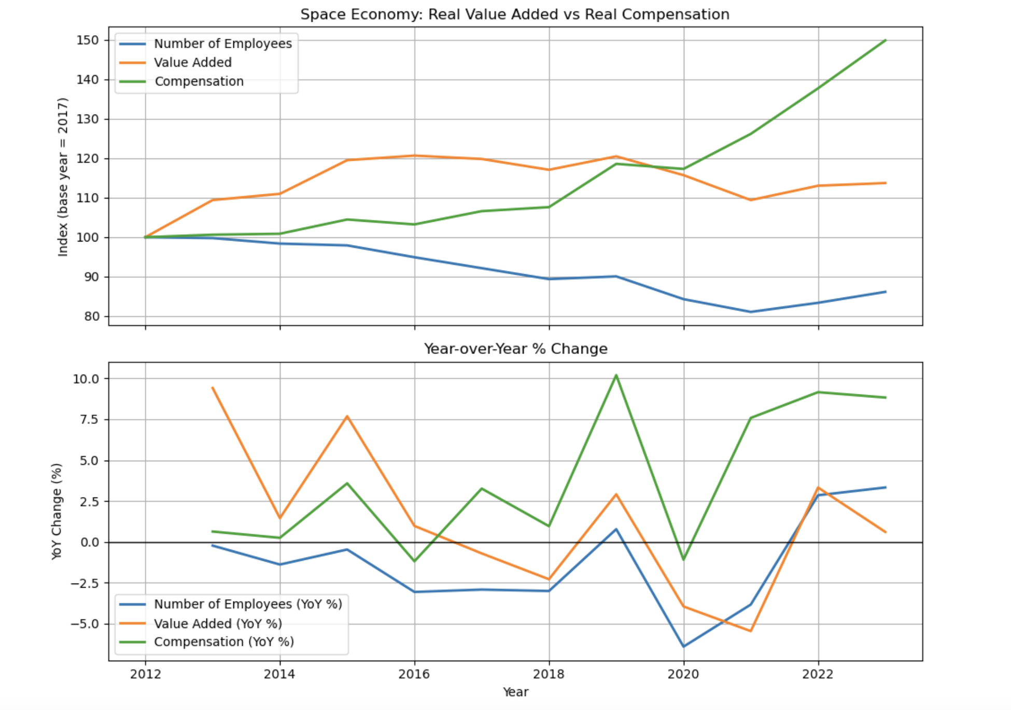
Interesting things to note: - While Value Added and the Number of Employees in the Space industry decreased, overall levels of compensation within the industry continued to rise.

Slide 21
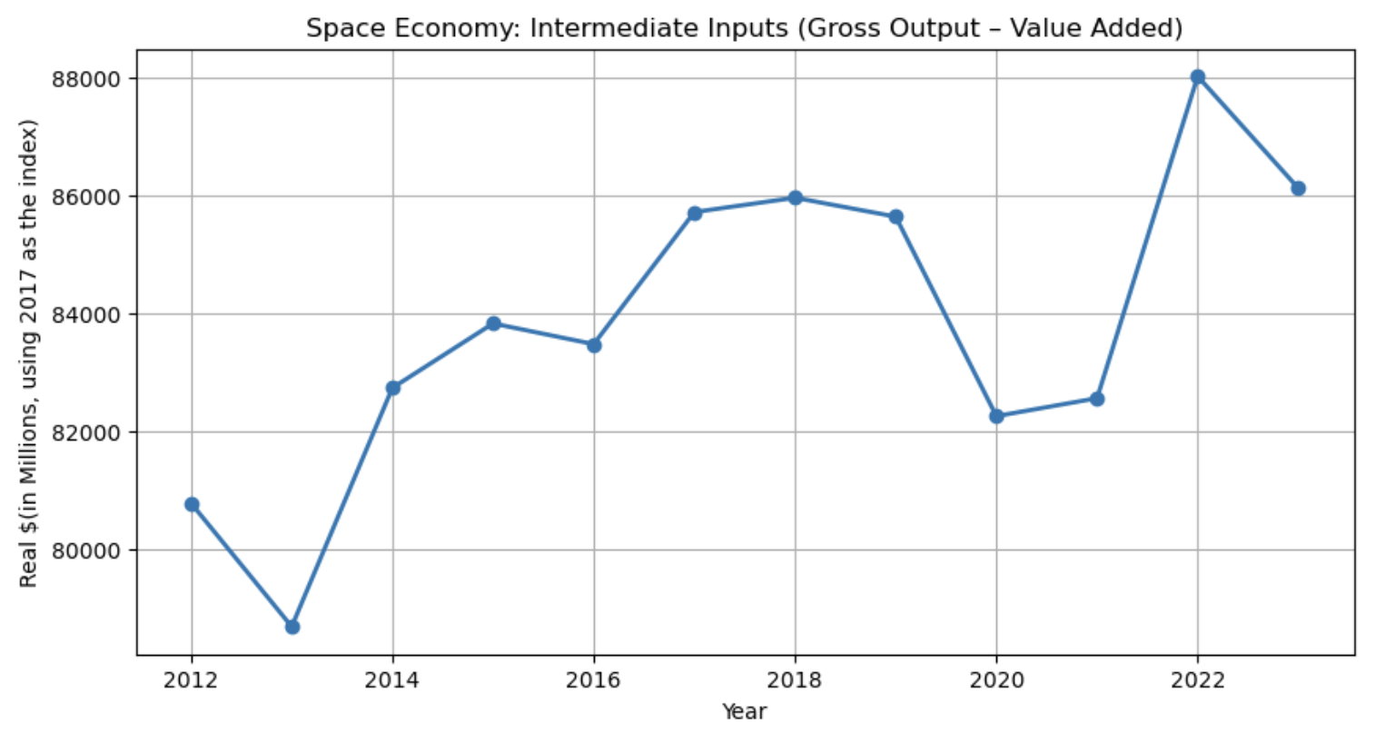
This figure tells us the intermediate inputs for the space economy. The intermediate inputs the space economy buys from other industries (manufacturing, IT, R&D, materials, logistics, etc.).
Notes:
This figure tells us the intermediate inputs for the space economy. The intermediate inputs the space economy buys from other industries (manufacturing, IT, R&D, materials, logistics, etc.).
Level of the series (~$80–88 billion real $) is how much value other industries contribute indirectly to the space economy’s output each year. It’s a proxy for the supply-chain footprint of the space sector.
The rising or falling trends show us that if intermediate inputs increase, the space economy is demanding more from its upstream suppliers (growth in its surrounding ecosystem). If they fall or stagnate, the sector may be shifting to more self-contained production or efficiency gains that reduce reliance on outside inputs.
The Volatility (like 2020 drop), likely reflects disruptions (COVID, supply chain shocks, etc.). When inputs dip sharply but VA doesn’t fall as much, it could mean more of the value is being produced internally to the space sector.
Relative to the value added, if intermediate inputs grow faster than value added, the sector is becoming more interconnected with other industries. If value added grows faster, the sector is capturing more of the value internally.

Slide 22
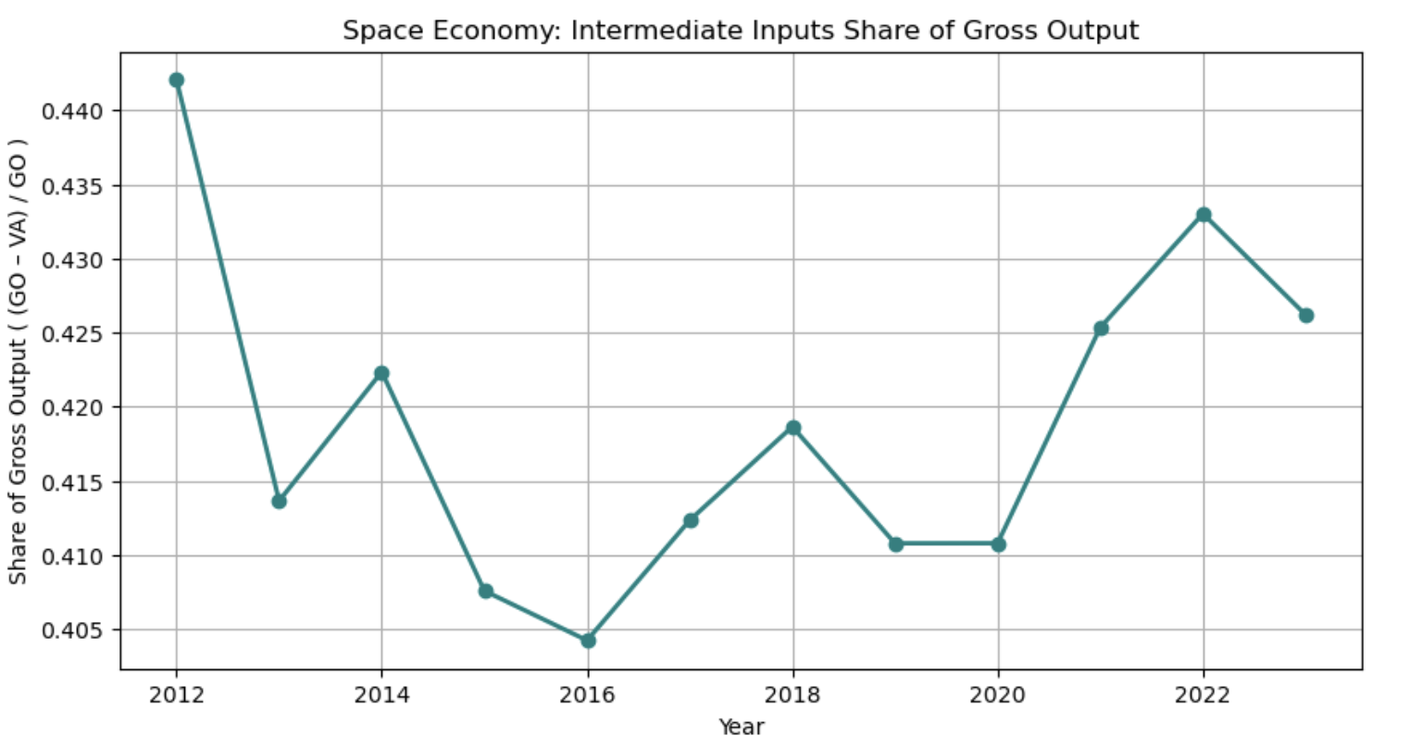
This figure shows the ratio between Gross Output and Value Added. High share (closer to 1): The space economy relies heavily on purchased inputs (materials, R&D, IT, logistics, etc.) from other industries, meaning strong supply-chain linkages. Low share (closer to 0): More of gross output is being generated internally as value added (wages, profits, capital income).
Notes:
If (GO – VA)/GO increases → space economy is becoming more dependent on upstream suppliers.
If it decreases → the sector is capturing more of the value itself (possibly through vertical integration, automation, or higher productivity).

Slide 23
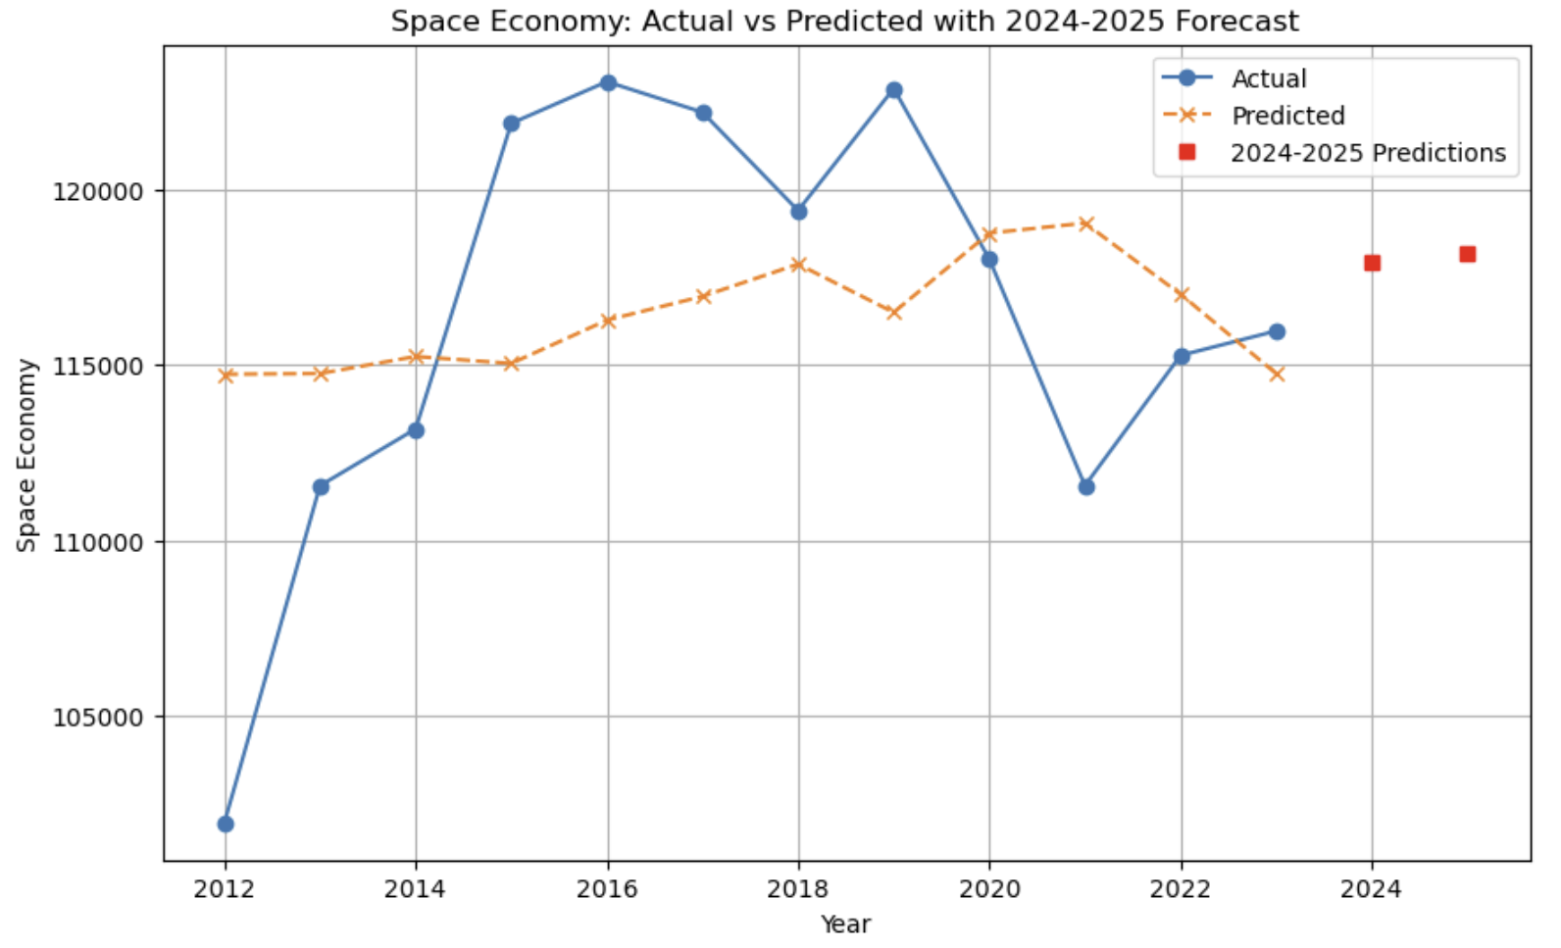
Linear Regression model using employee compensation and total number of employees to predict the space economy. R²: 0.062 RMSE: 5782 Coefficients: Employees: -84.98276295703486 Compensation: -0.22107702606062415
118165
117930

Slide 24
05
Findings

Slide 25
Findings
Industries that make up the majority of the space sector may have a bigger influence on the total space economy, but smaller industries such as recreation and retail have more potential to have a larger impact
There exist some industries such as mining and finance where increasing the economy within it can negatively impact the total space economy
Employee compensation and number of employees did not turn out to be good predictors for the space economy

Slide 26
Closing Thoughts

Slide 27
Closing Thoughts: Overall Findings
Shift Away from Satellites: The space economy has become less dependent on satellites over the past decade, with growth increasingly coming from non-satellite industries such as manufacturing, information, and government. This shows the sector is diversifying and broadening its base.
Industry composition: Manufacturing and information consistently anchor both gross output and compensation, highlighting their role as the drivers of value creation and employment.
Labor-driven growth: Rising compensation, especially in labor-intensive industries like manufacturing, demonstrates how much of the space economy’s expansion is being channeled into jobs and wages.
Supply chain linkages: By comparing gross output with value added, we see that intermediate inputs are substantial, and that the space economy is deeply interconnected with upstream industries.
Looking forward: Our regression models suggest that total real value added in the space economy will continue to grow in the coming years, though at a more moderate and possibly more volatile pace than in the pre-2017 period. This means the space economy is poised to remain an important growth driver, but one whose trajectory will depend on innovation, policy support, and resilience to shocks.

Slide 28
Closing Thoughts: Data
After completing the project we realized that the data itself does not have enough predictors to create a strong model for predicting the Space Economy’s growth.
Additionally, the time frame is not long enough. Over the past year, there were many large swings that are not strong reflections of the space economy.
Finally, there are too many outside factors that effect the data. For example, a majority of the swings in Total Value can be explained by Covid or more macroeconomic factors that we did not have data for. Thus, this heavily effected the fit of our model and its outcome.
Moving forward, we want to find more data that could potentially help us in explaining the space economy’s growth.

Slide 29
References
SlidesGo for the slide template
Dataset and statistics provided by the Bureau of Economic Analysis (BEA), U.S. Department of Commerce.
Use of generative AI to assist in plot making

